Slide 1
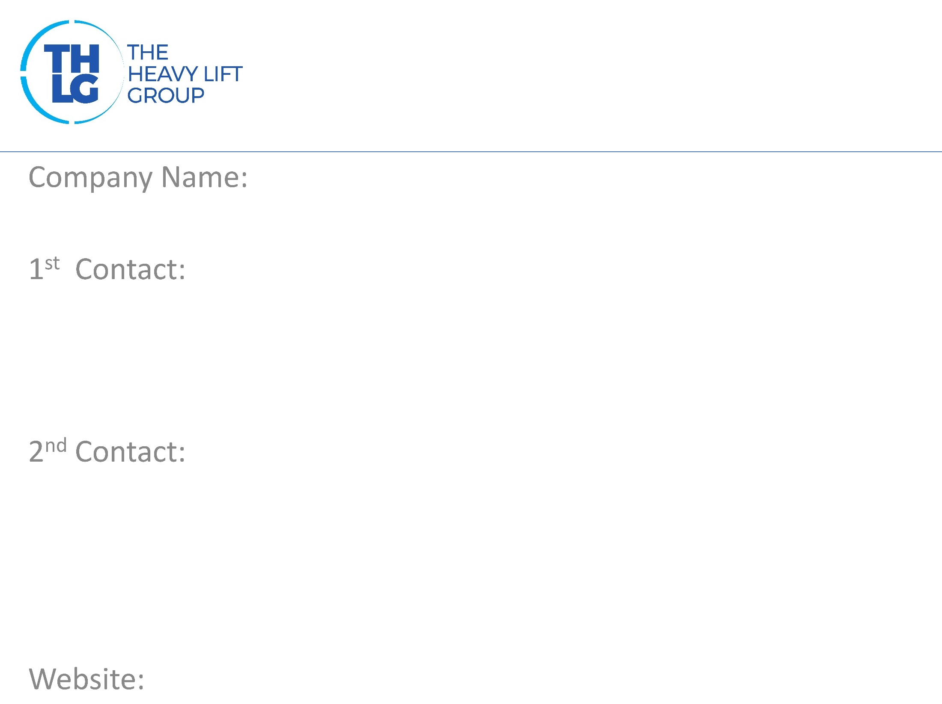
TURKEY THLG member since 2006
KITA LOGISTICS
Mr. CAN YILBASI/ Project Logistics Manager T: +902124104141/ ext. 1017 M:+90 5333234272 can.yilbasi@kitalogistics.com
Mr. Cem ERCAN/ Project Logistics Supervisor T: +902124104141/ ext. 1019 M:+90 5303852432 cem.ercan@kitalogistics.com & project@kitalogistics.com
www.kitalogistics.com

Slide 2
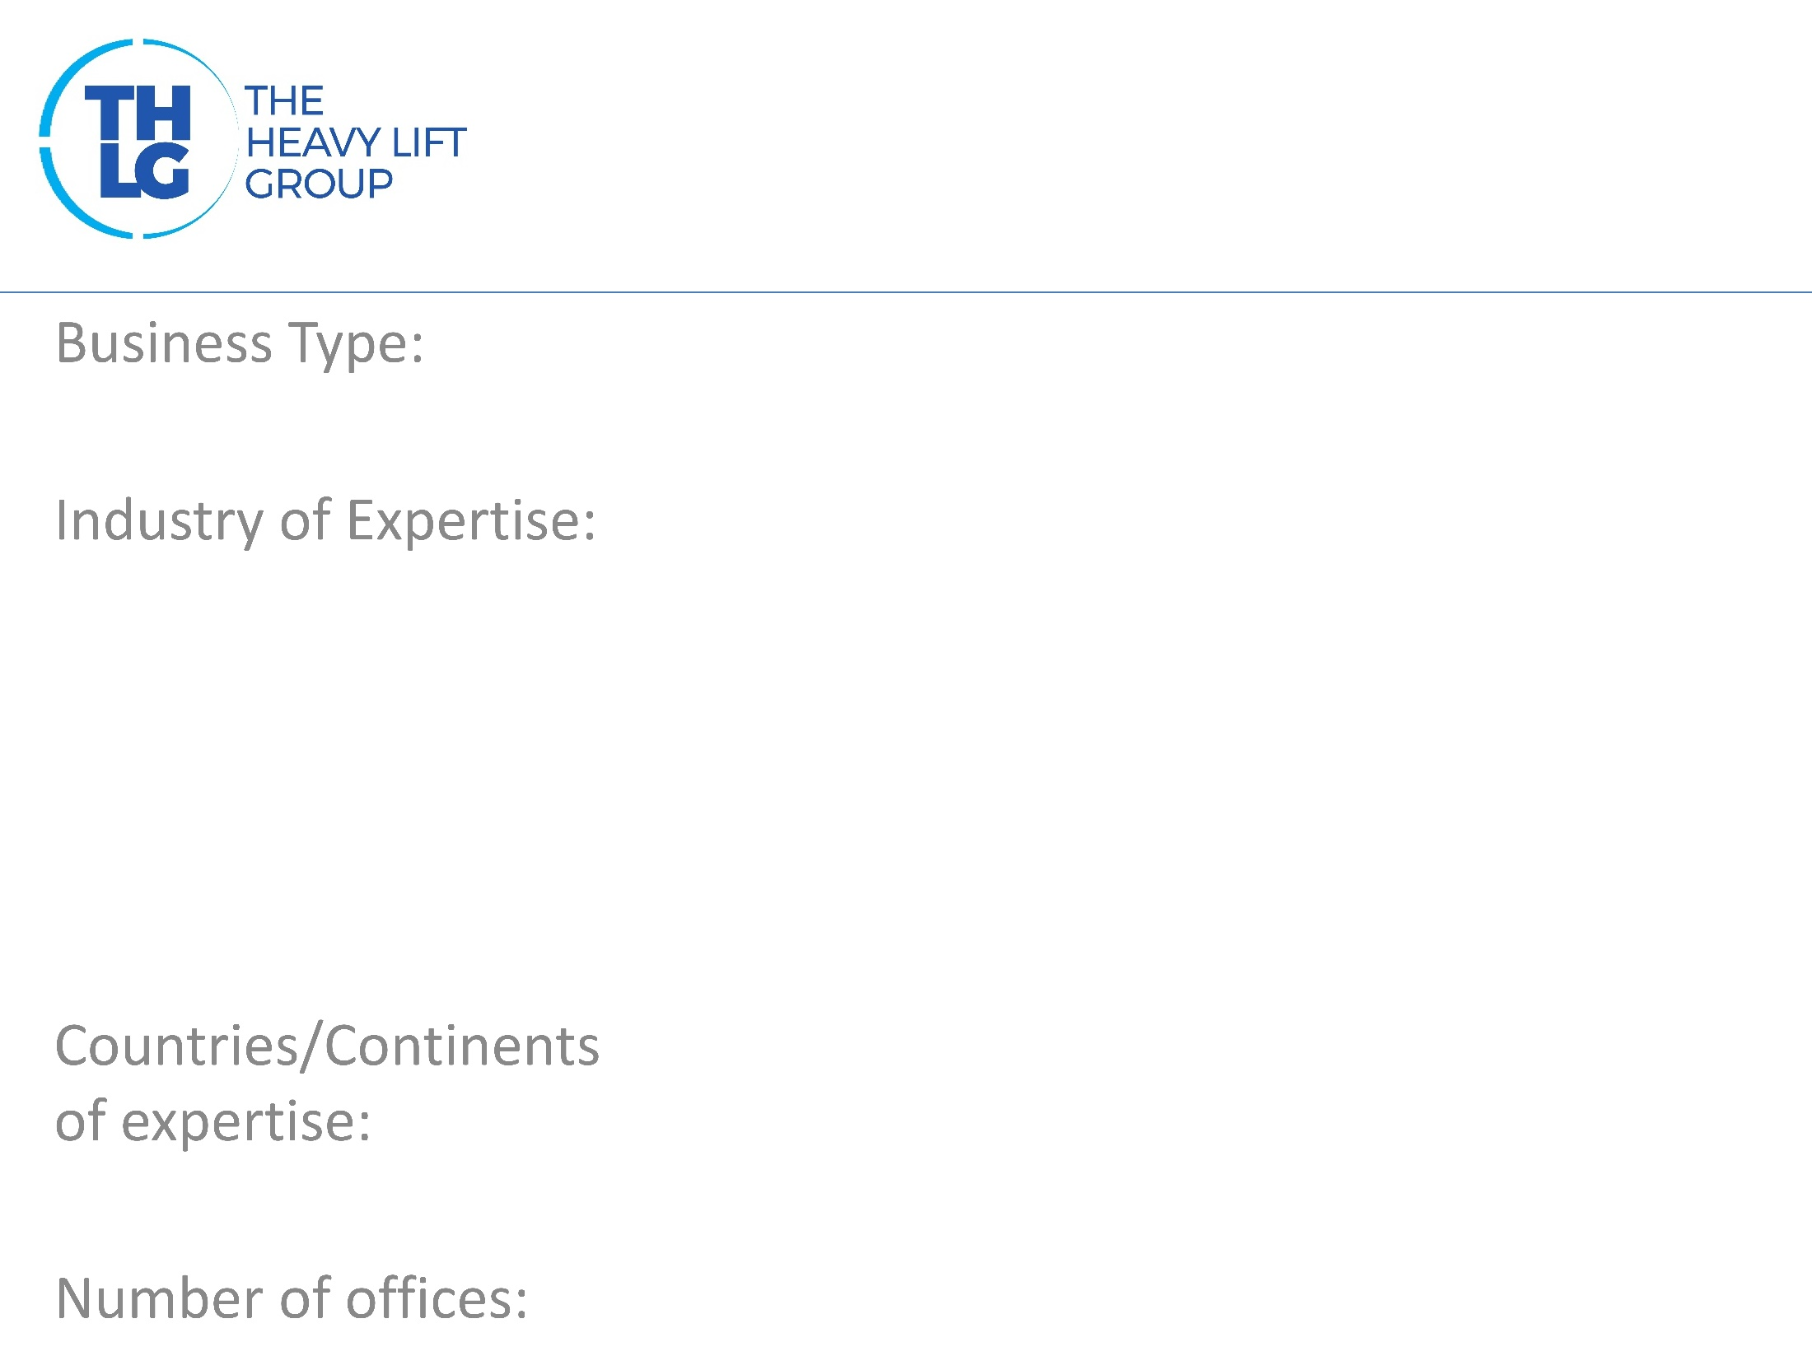
TURKEY THLG member since 2006
Freight Forwarders – NVOCC
Oil & Gas Power: Natural Gas, Coal, Hydro,Wind,Solar Mining & Cement – Production Plants Military/Defence Construction / Infrastracture Railcars/Shipyard/Machinery
Middle East, Central Asia, Iraq, Far East , Europe, USA
Turkey-5/ Kazakhstan – 1 / Saudi Arabia – 1 /

Slide 3
TURKEY THLG member since 2006

Slide 4
TURKEY THLG member since 2006
*Road and sea and/or multimodal transport solutions on a worldwide basis *Full and part chartering globally *All types of lifting, skidding, jacking equipment rentals *Packing/Crating for break bulk cargoes *Route survey reports, engineering studies *Port/Jobsite supervisions *Process management for industrial projects*Warehousing *Rail Freight *Airfreight

Slide 5
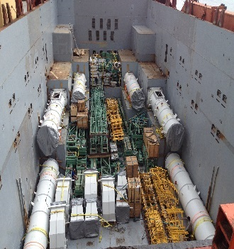
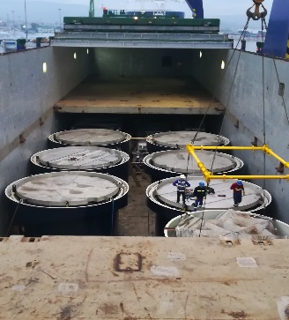
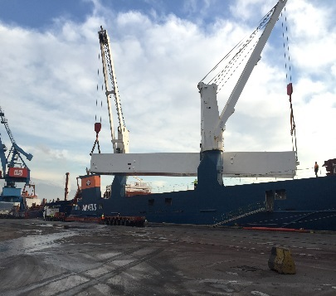
TURKEY THLG member since 2006
Join us on social media
Oil & Gas
Mining
Production Plants
Read all about our projects:
http://kitalogistics.com/Services/4/project-logistics
Participation in other Groups:

