Slide 1
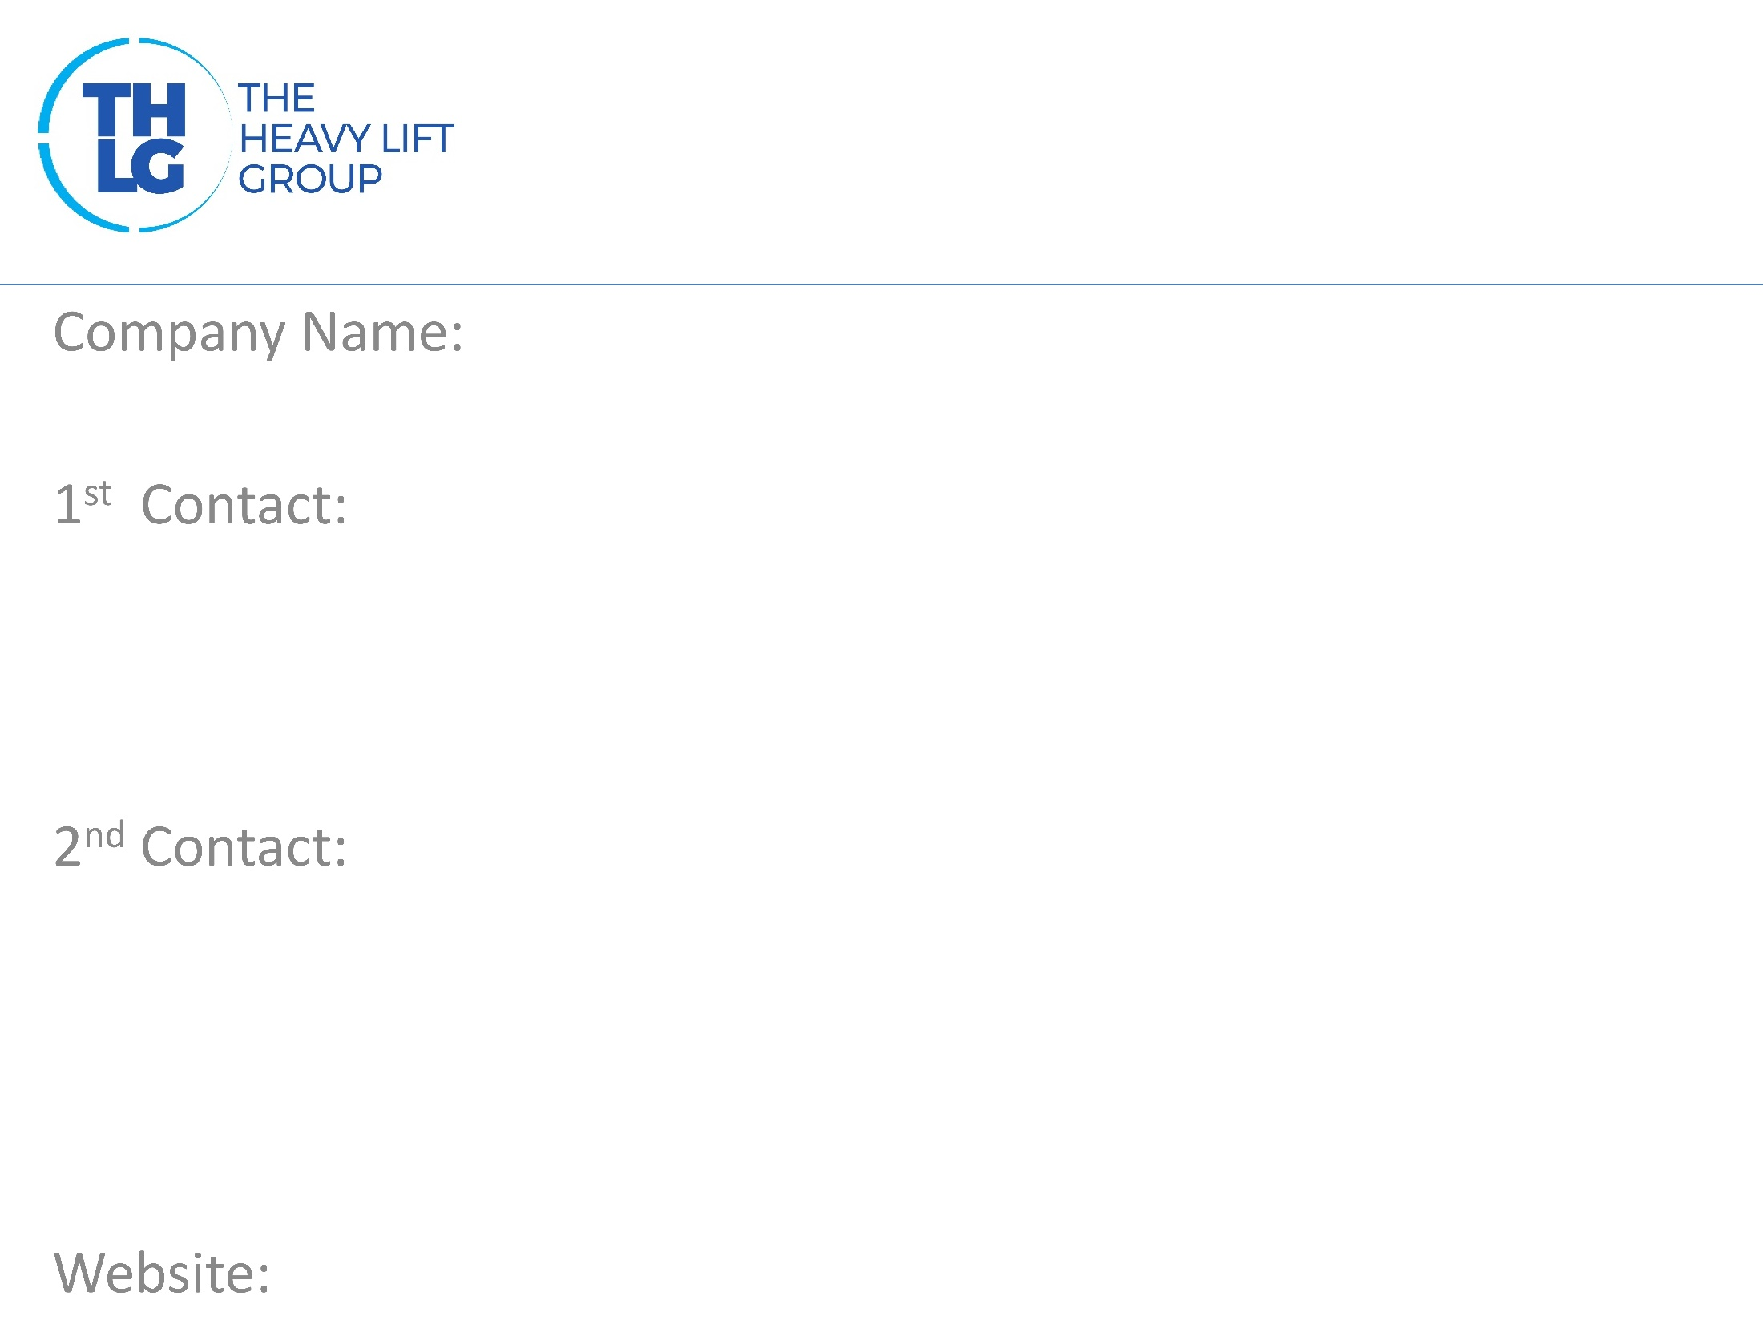
BULGARIA THLG member since 2013
Holleman Bulgaria OOD
Mr. Mladen Ganchev / Managing Director T: +359 82 842886 M:+359 88 6211715 Mladen_Ganchev@holleman.bg
Mr. Lyubomir Mihaylov T: +359 82 842886 M:+359 88 //90711 info@holleman.bg
www.holleman.bg

Slide 2
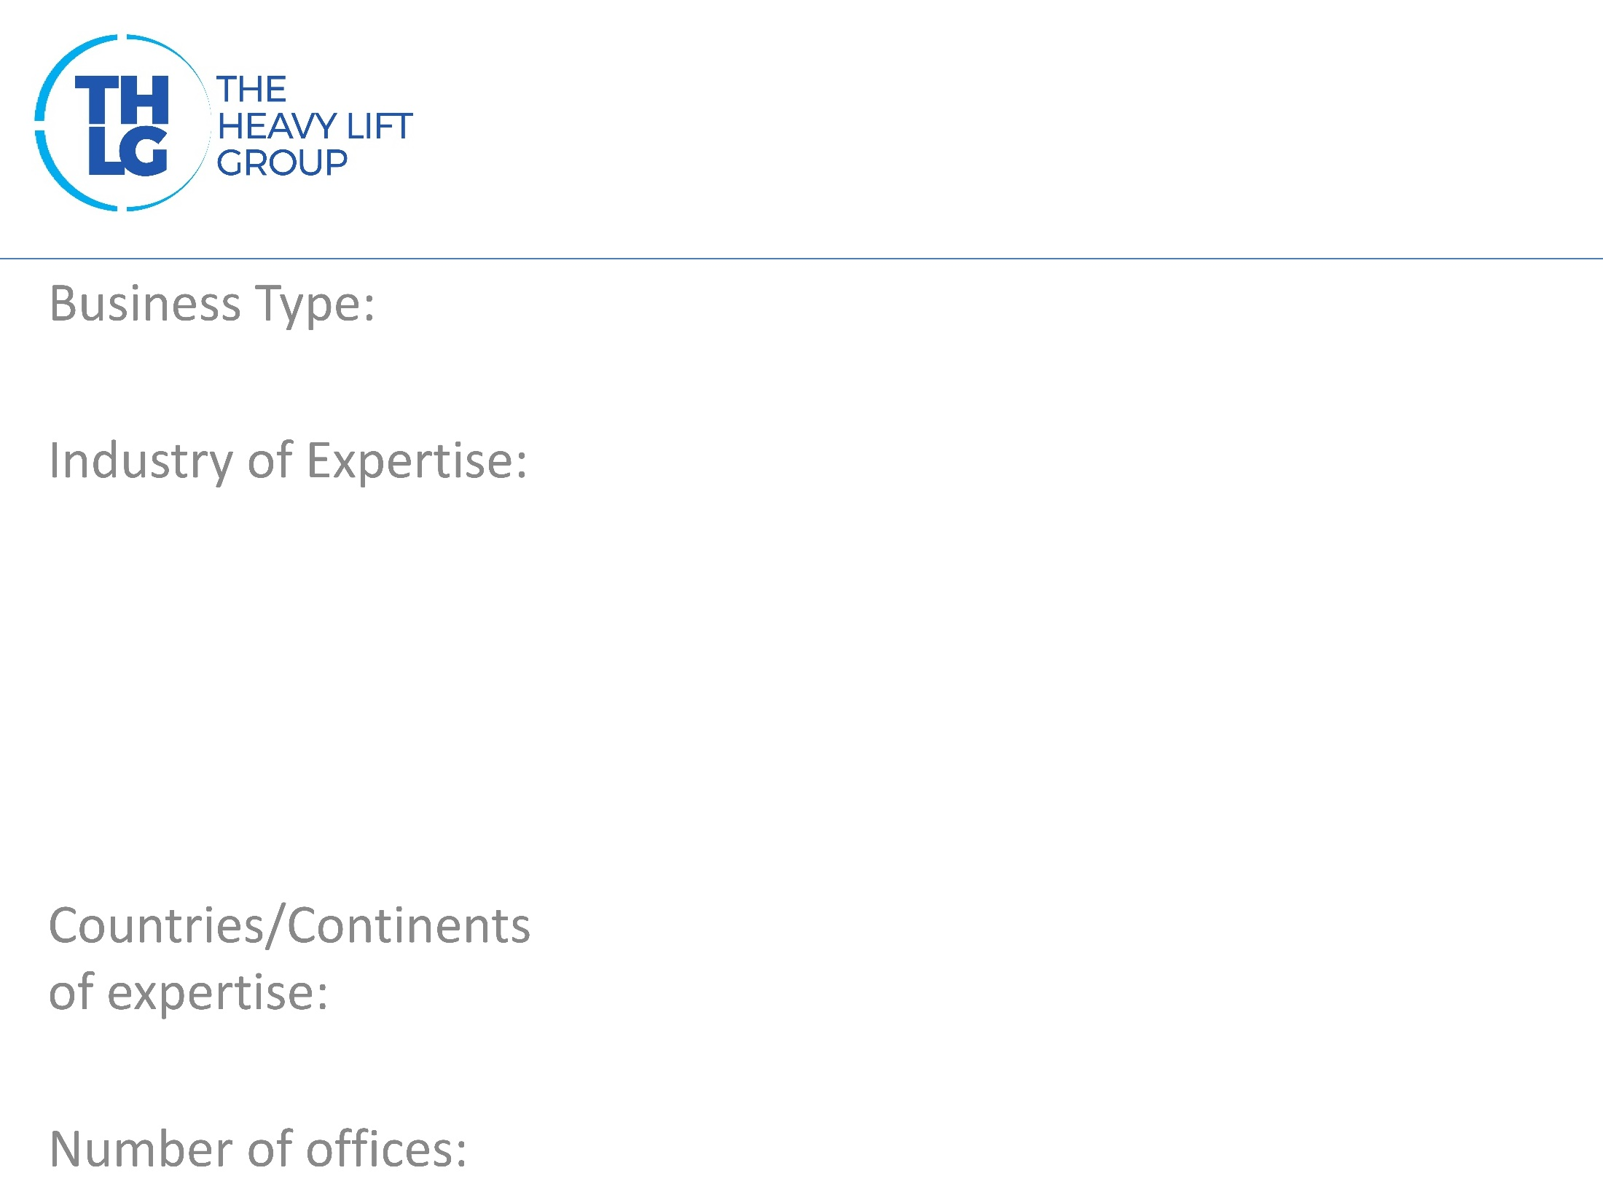
BULGARIA THLG member since 2013
Truck equipment owner / River transports
Wind power Mining Military Machinery Agriculture
Europe
3 - Bulgaria

Slide 3
BULGARIA THLG member since 2013

Slide 4
BULGARIA THLG member since 2013
International Road Transport National Road Transport Port operations Ship brokerage Project planning, management and execution Customs Formalities Warehousing LCL/FCL

Slide 5
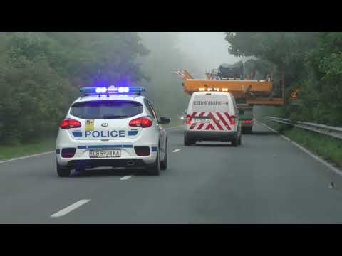
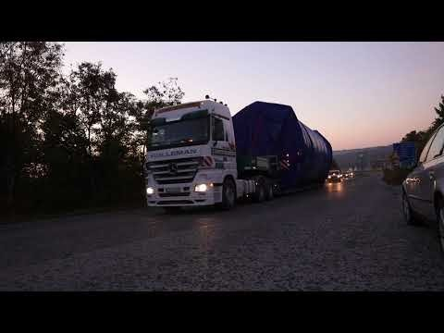
BULGARIA THLG member since 2013
Join us on social media
Participation in other Groups:

