Slide 1
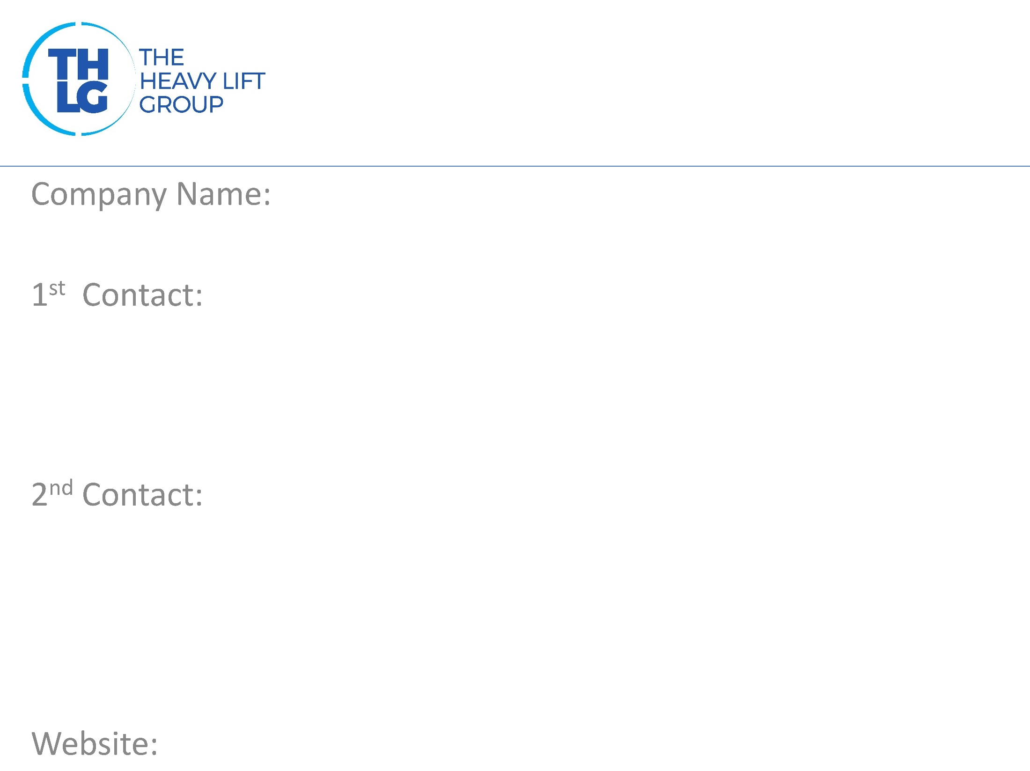
LUXEMBOURG THLG member since 2009
Transpalux sàrl – P. Adams
Mr. Peter Adams - Managing Director T: +32 80 57 91 94 peter@p-adams.eu
Mr. Stephan Adams T: +352 97 93 93 23 stephan@p-adams.eu
www.p-adams.eu

Slide 2
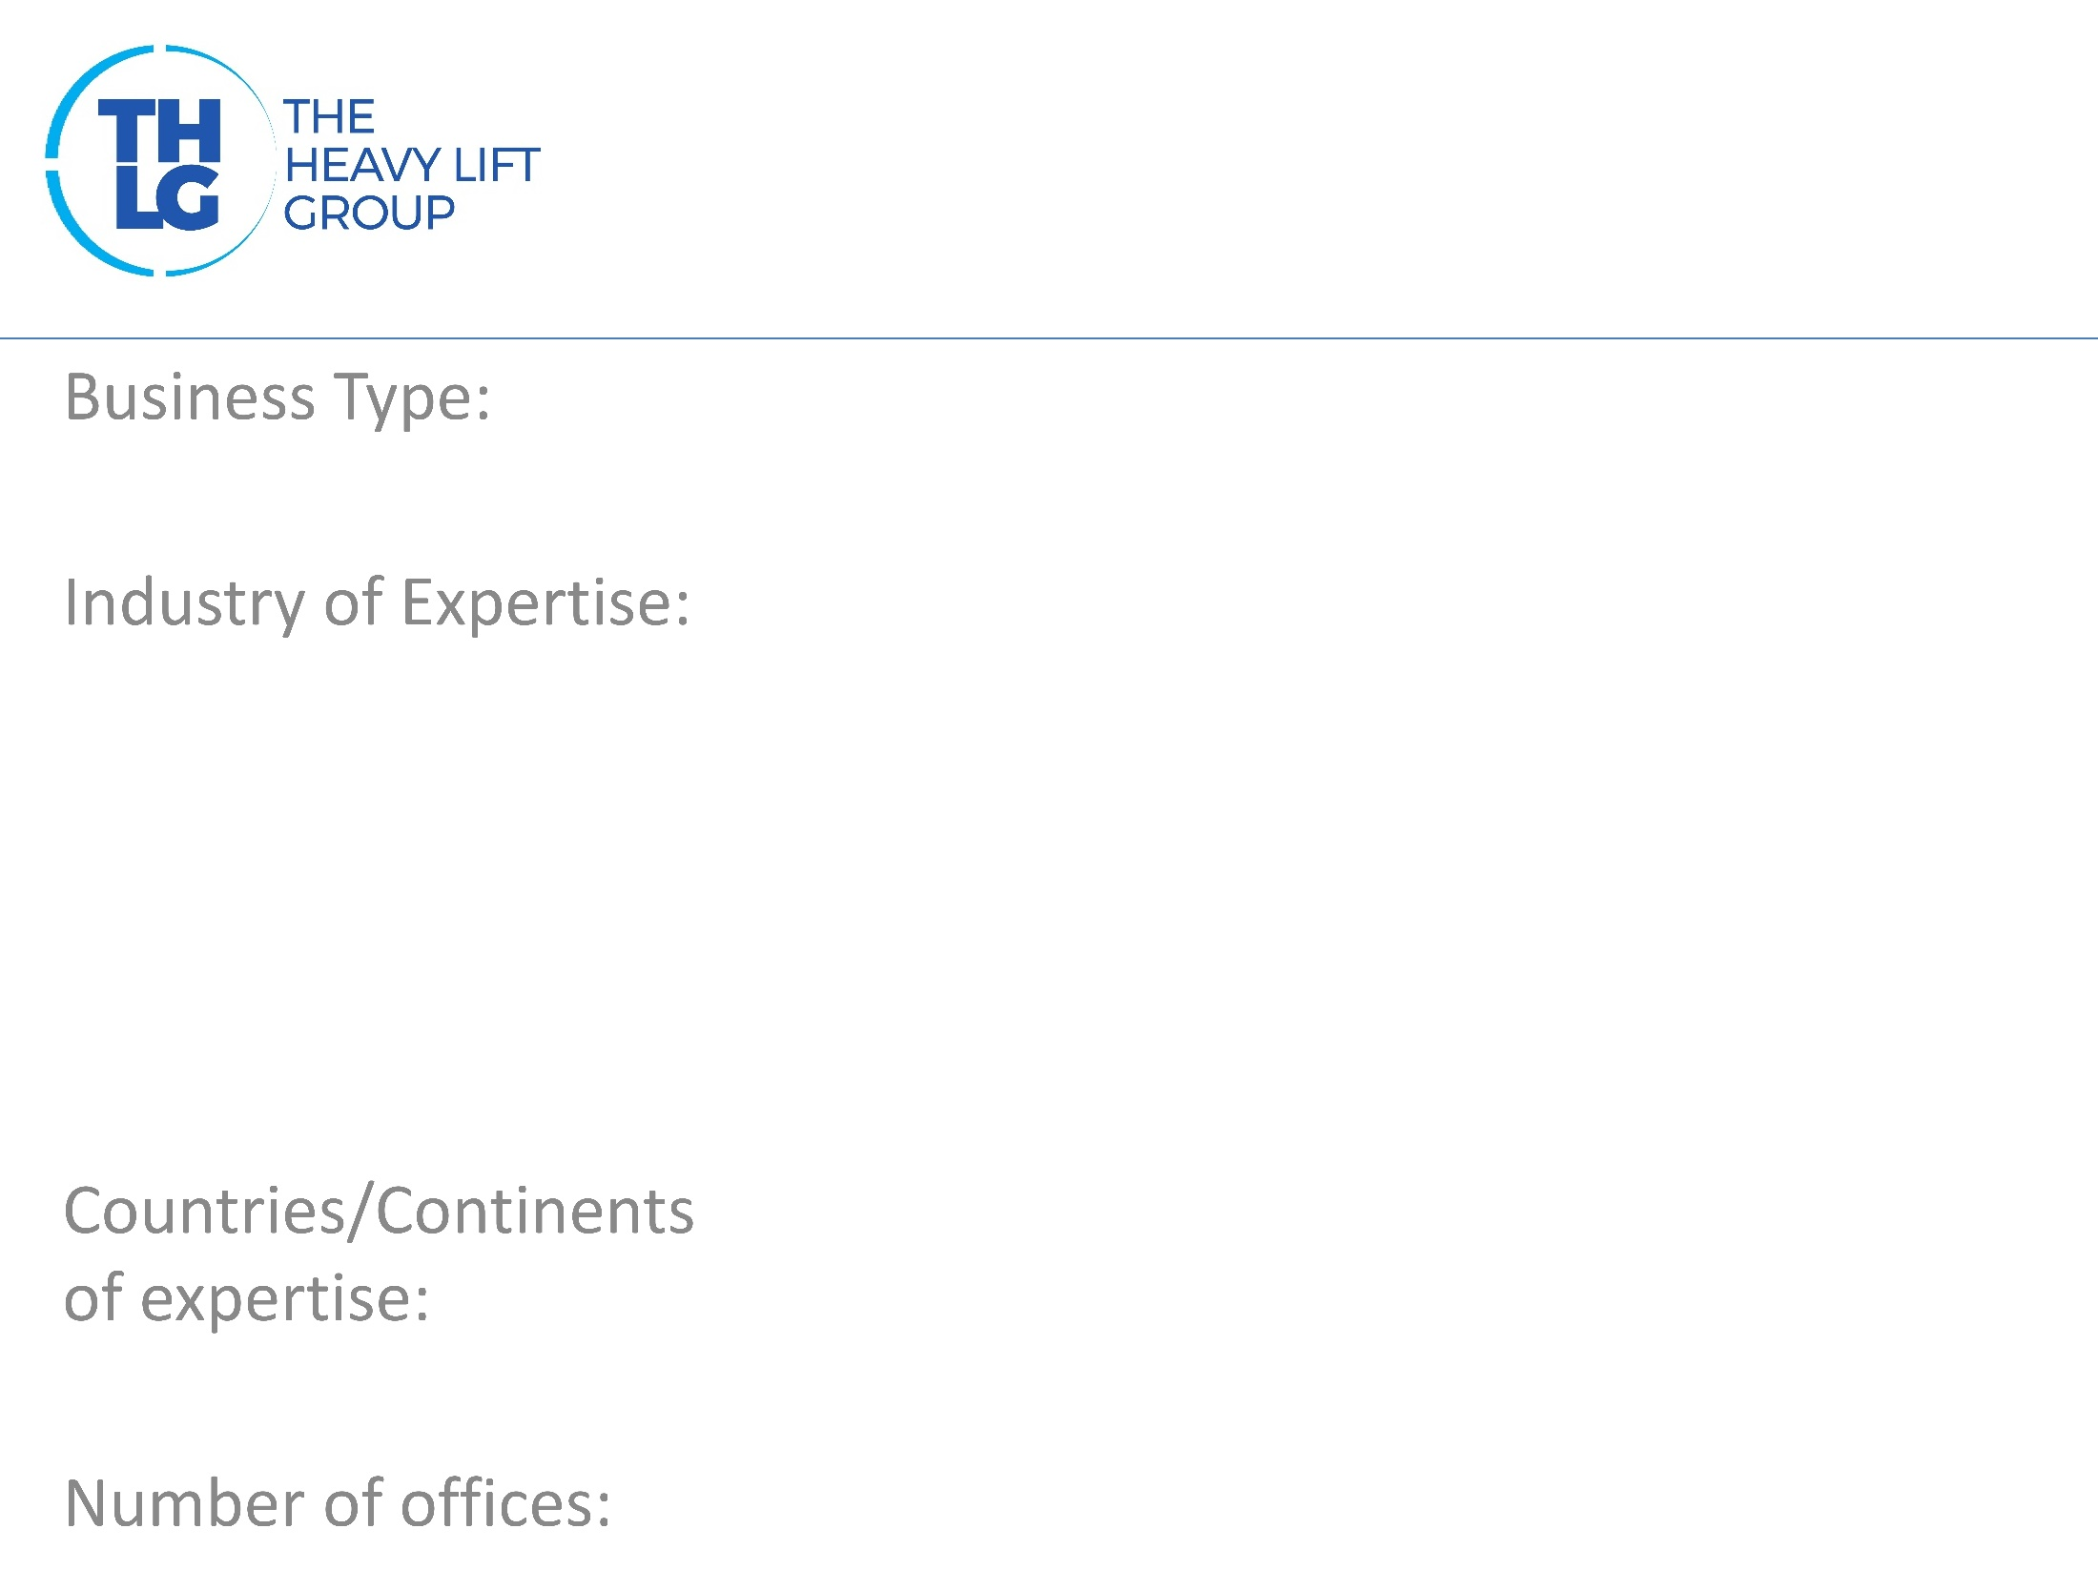
LUXEMBOURG THLG member since 2009
Heavy haulage trucking & project management
Wind energy Gas turbines & generators Mining equipment Transformers Petrochemical
Benelux, France, Germany And Europe-wide
3 (Luxembourg, Belgium, Germany)

Slide 3
LUXEMBOURG THLG member since 2009

Slide 4
LUXEMBOURG THLG member since 2009
Heavy haulage trucking with own fleet Freight forwarding Project management including barging, crane & installation, port handling Feasibility studies including route surveys, loading simulations, project pricing Rental of equipment such as SPMTs, fly-over bridges, etc.

Slide 5
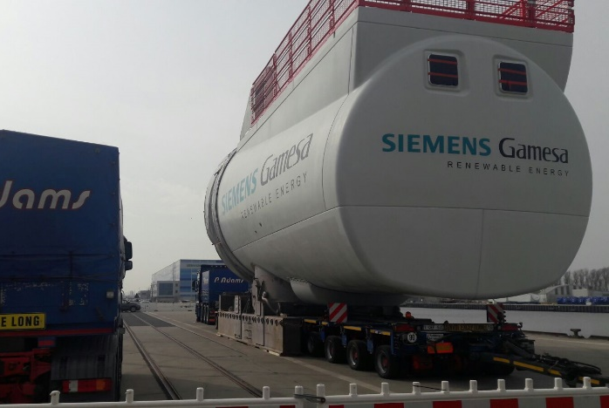
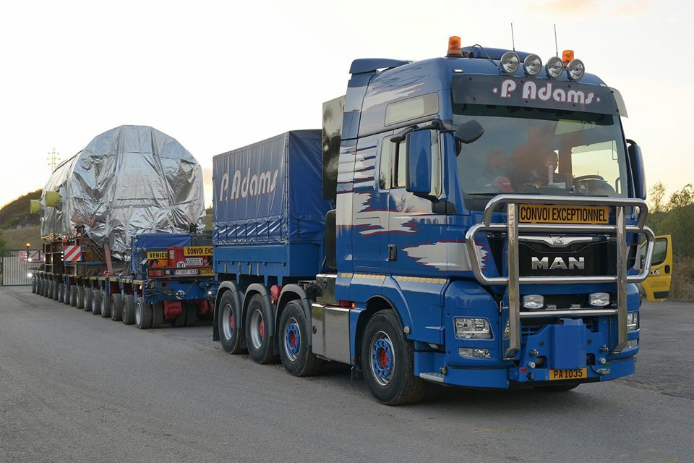
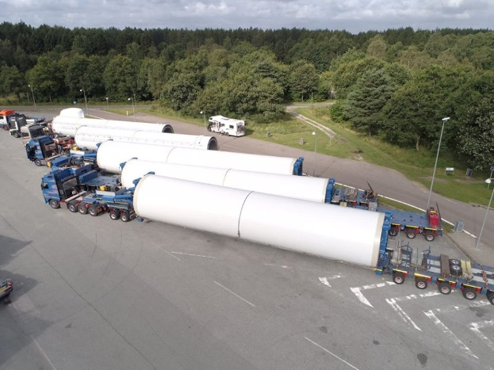
LUXEMBOURG THLG member since 2009
Offshore nacelle 290 to
Generator 180 to
Various tower sections
Participation in other Groups:

