Slide 1
INDIA THLG member since 2011
MFC Transport Private Limited
Mr. Pawan Agarwal Director T: +91 22 28795503 M:+91 9820322077 pawan@mfctransport.com
Mr. Rajsekhar Dey Vice President - Projects T: +91 22 28795505 M:+91 9819087133 Mayank.kaushal@mfctransport.com
Mr. Vinod Padmanabhan Vice President - Projects T: +91 22 28795505 M:+91 9819087133 vinod.padmanabhan@mfctransport.com
www.mfctransport.com

Slide 2
INDIA THLG member since 2011
Project Forwarding, Transportation, Heavylift
Power: Wind, Thermal, Nuclear, Solar Mining Military Industrial Projects Petrochemical Oil and Gas Infrastructure
India, Nepal, Bangladesh, Srilanka
30

Slide 3
INDIA THLG member since 2011

Slide 4
INDIA THLG member since 2011
End to End Supply chain Management Project Forwarding & Logistics Transportation – General Cargo Transportation – ODC & OWC Movements Sea and Air Charter Customs Clearance and Consultancy Route Survey and Feasibility Study Material Handling and Equipment Hiring Heavy Haulage and Lifting Building Jetties and By-Passes Anchorage Discharge Multi-Modal Transportation Placement on Foundation Inventory and Site Management Warehouse Management

Slide 5
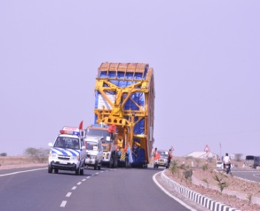
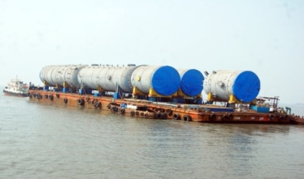
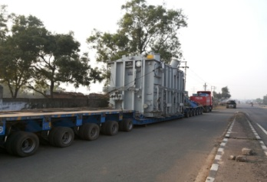
INDIA THLG member since 2011
Join us on social media
Nuclear Power
Multi-Modal
Transformer
Read all about our projects:
Visit our Corporate Blog
Participation in other Groups:

